Slide 1
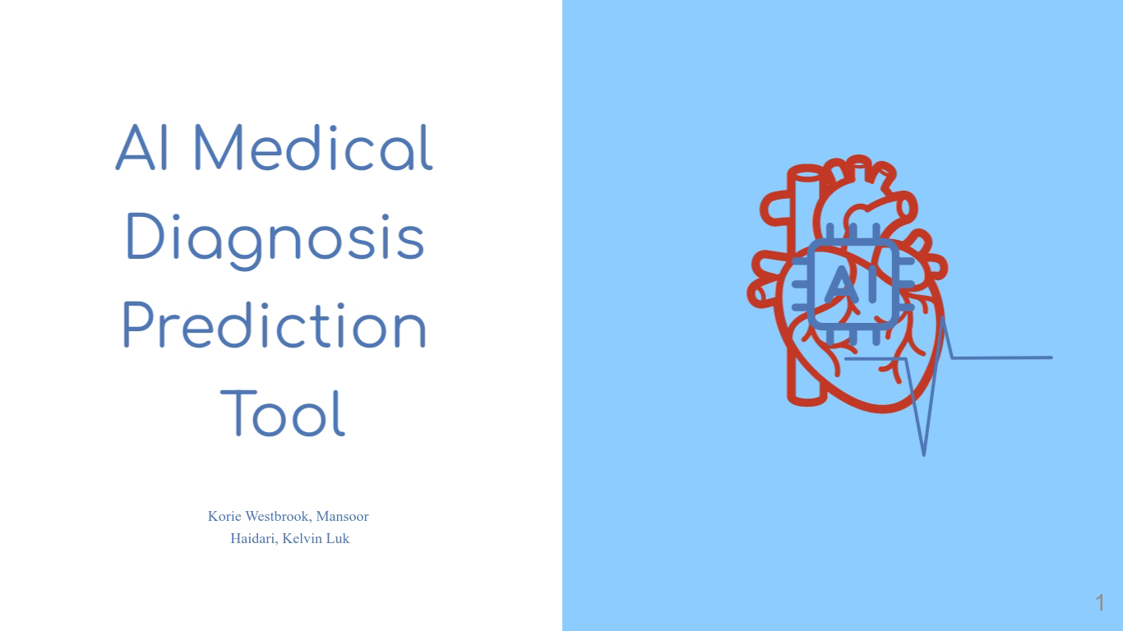

Slide 2
Introduction
Heart disease is the leading cause of death worldwide, causing millions of fatalities annually.
The goal of the Project is to develop an AI Medical Diagnostic Tool that uses machine learning to predict heart diseases or conditions based on patient data, medical history, and test results.
This project aims to create an AI-powered medical diagnosis prediction tool using machine learning algorithms to predict heart disease based on patient data.

Slide 3
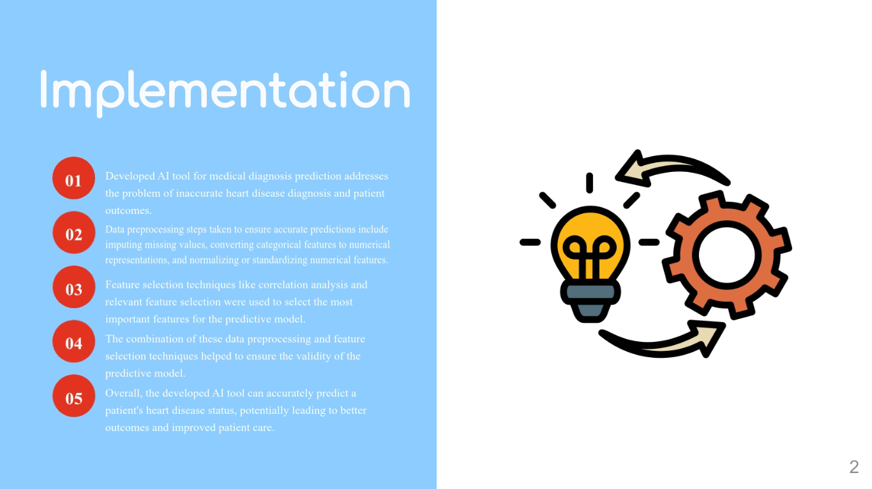

Slide 4
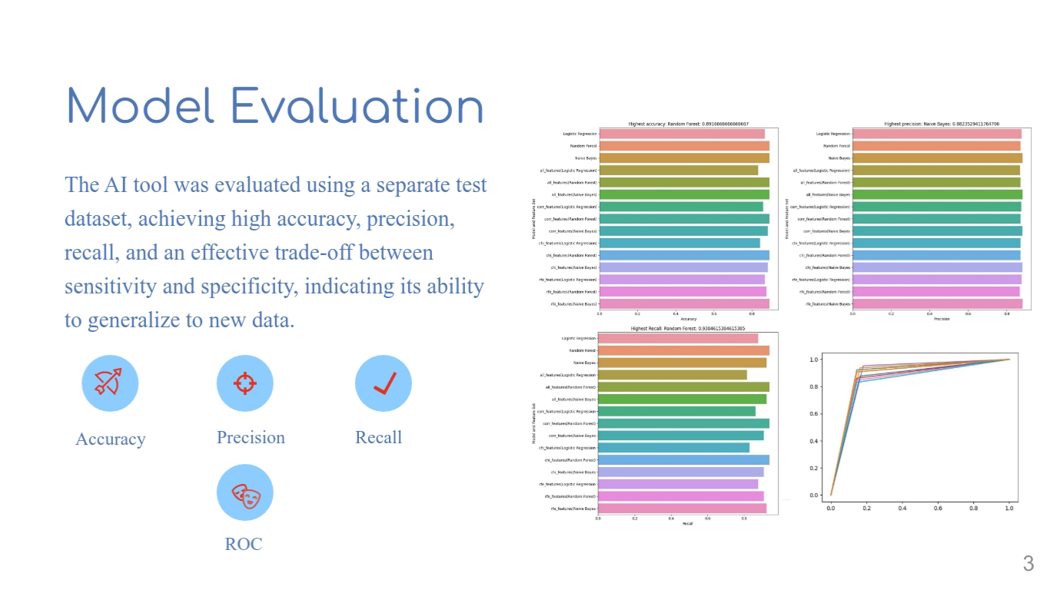

Slide 5
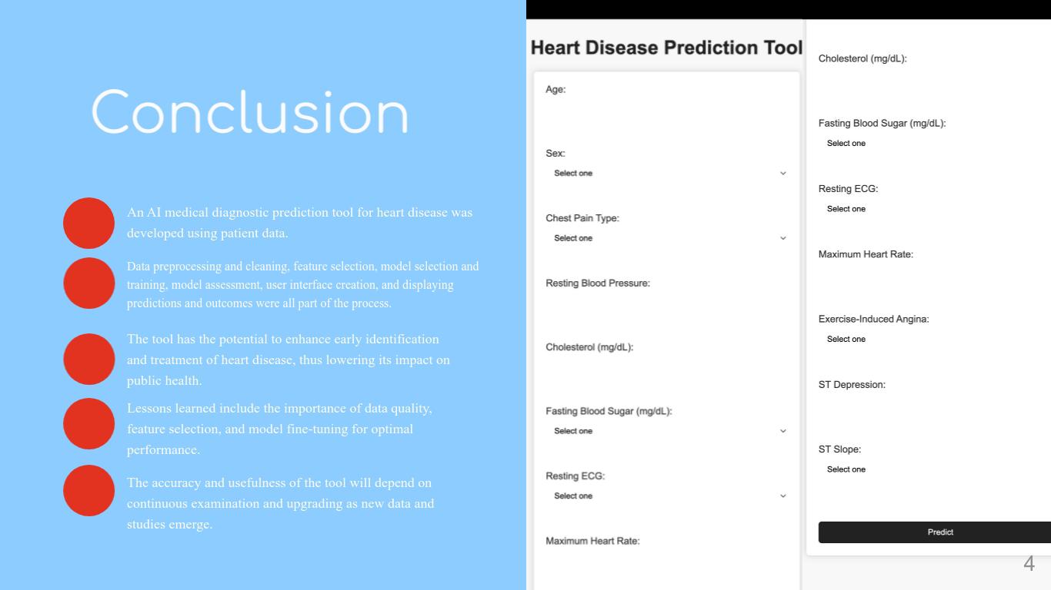

Slide 6
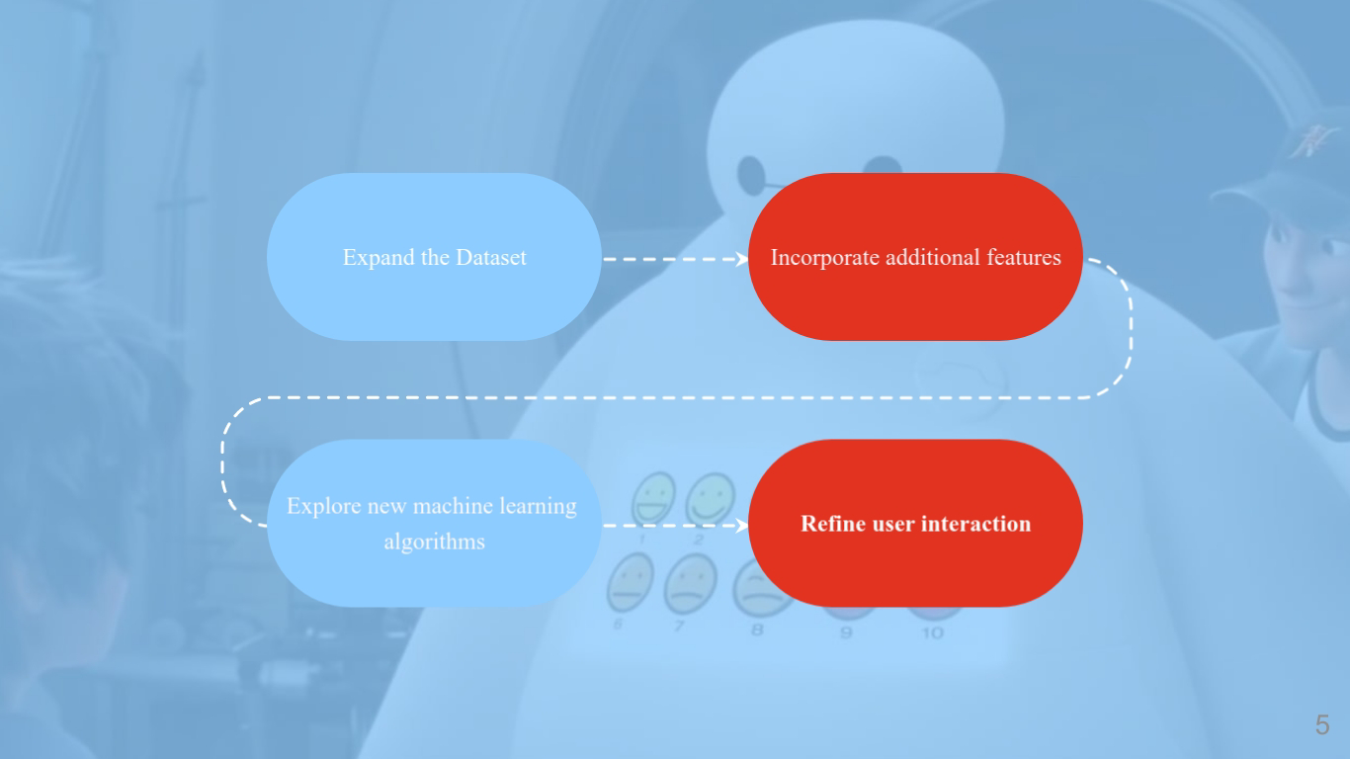

Slide 7
